Slide 1
Sequential Logic
Registers

Slide 2
What is Register?
Group of flip-flops.
n bit register consists n numbers of flip flops.
Stores multi bit data.

Slide 3
Shift Register
It can shift the binary information stored in flip-flop either to left or right.
Types:
Serial In Serial Out Register(SISO)
Serial In Parallel Out Register(SIPO)
Parallel In Serial Out Register(PISO)
Parallel In Parallel Out Register(PIPO)

Slide 4
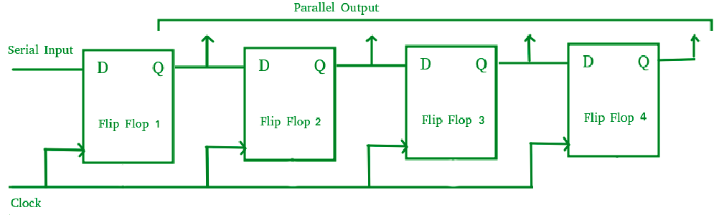
Serial In Parallel Out Register(SIPO)
1101
1 1 1 1 0 0 1 1
1 1 0 0 1 1 0 0
0 0 1 1 0 0 0 0
1 1 0 0 0 0 0 0
0 0 0 0
1
1
2
2
3
3
4
4

Slide 5
Serial In Parallel Out Register(SIPO)
1101
Clk | Q1 | Q2 | Q3 | Q4
Intially | 0 | 0 | 0 | 0
1 | 1 | 0 | 0 | 0
2 | 0 | 1 | 0 | 0
3 | 1 | 0 | 1 | 0
4 | 1 | 1 | 0 | 1

Slide 6
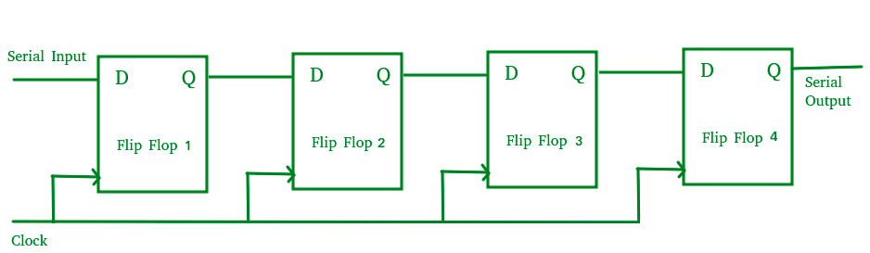
Serial In Serial Out Register(SISO)
1101
0 0 0 0 0 0 1 1
0 0 0 0 1 1 1 1
0 0 1 1 1 1 0 0
1 1 0 1
2
3
3
4
4
1
1
2

Slide 7
Serial In Serial Out Register(SISO)
1101
Clk | Q1 | Q2 | Q3 | Q4
Intially | 0 | 0 | 0 | 0
1 | 1 | 0 | 0 | 0
2 | 0 | 1 | 0 | 0
3 | 1 | 0 | 1 | 0
4 | 1 | 1 | 0 | 1
5 | 0 | 1 | 1 | 0
6 | 0 | 0 | 1 | 1
7 | 0 | 0 | 0 | 1
1101

Slide 8
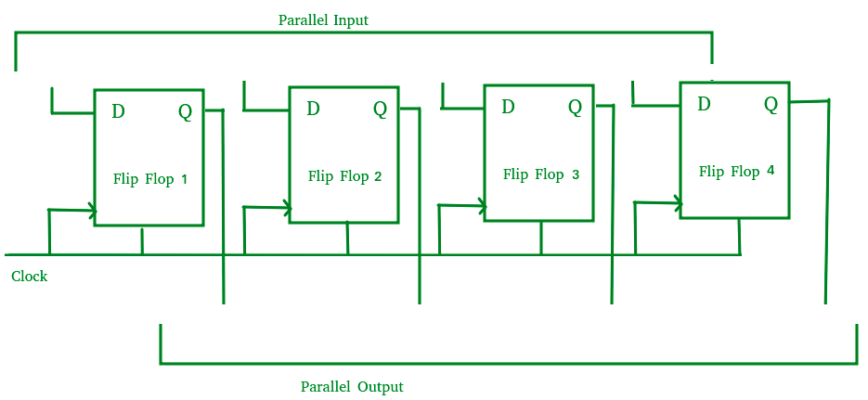
Parallel In Parallel Out Register(PIPO)
1101
1 1 0 1
1
1
2
2
3
3
4
4
1 1 0 1

Slide 9
Parallel In Parallel Out Register(PIPO)
1101
Clk | Q1 | Q2 | Q3 | Q4
Intially | 0 | 0 | 0 | 0
1 | 1 | 1 | 0 | 1

Slide 10
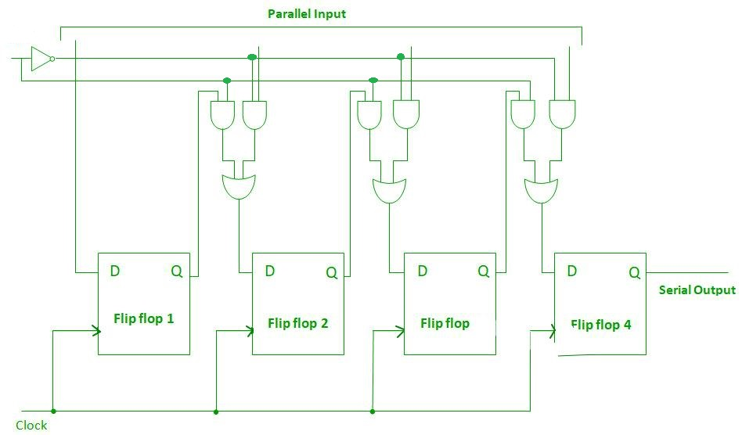

Parallel In Serial Out Register(PISO)
1101
1 1 0 1
Shift/$\overline{Load}$
1
1
2
2
3
3
4
4

